Slide 1
Adult Recognition
Scissortail District
Roundtable
Bill Hensley
Scoutmaster, Scouts BSA Troop 15
20 January 2022
1

Slide 2
Why adult recognition?
It’s a great motivator! It’s deserved.
Our adult volunteers work hard for our Scouts.
Sometimes it’s more than an hour a week.
2

Slide 3
Formal Adult Awards
BSA recognition of volunteer service
Spread across all programs (Cubs, Scouts BSA, Venturing, Sea Scouting)
Most require another person to nominate
Requirements are online
3

Slide 4





Self-Earned
Arrow of Light
Eagle, QM, and Summit
Adult Religious Award
4

Slide 5



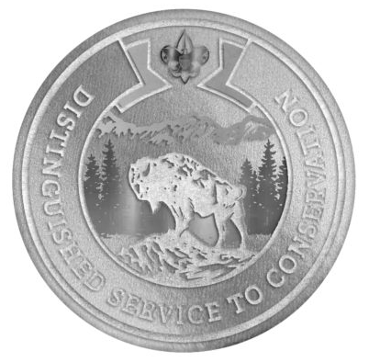
Awards For Unit Level Volunteers
Scouters Training Award
Unit Leader Award of Merit
Boyce New-Unit Award
BSA Distinguished Conservationist
Tenure, training, plan, JTE
SM/CM/Skipper, tenure, training, succession plan
Start a new traditional unit
Conservation Service; youth also
5

Slide 6



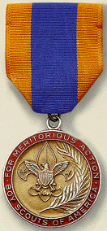

Awards For Unit Level Volunteers
Alumni Award
Community Organization Award
Scouters Key
Medal of Merit
Recruit a Scouting alumni back into Scouting
Be recognized by an organization (Rotary, etc)
Unit leaders, District Committee members
Significant service using Scouting skills
6

Slide 7

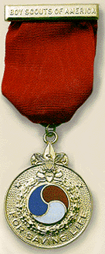



Awards For Unit Level Volunteers
Den Leader Award
Lifesaving and Meritorious Action
Award
International Scouters Award
Venturing Leadership Award
Tenure, retention
Giving leadership to international Scouting events
Unit level to National
7

Slide 8




Awards For Unit Level Volunteers
Whitney M Young Jr Service Award
¡Scouting! Vale la Pena! Service Award
Asian American Spirit of Scouting
Service Award
PTC Masters Track Award
Service to rural or low-income youth
Service to rural or low-income youth
Scouting opportunities for Hispanic/Latino youth
Scouting opportunities for Asian American youth
Taking PTC training, and giving training
8

Slide 9



Awards For Commissioners
Excellence in Unit Service
Distinguished Service Award
Doctorate of Commissioner Science
9

Slide 10

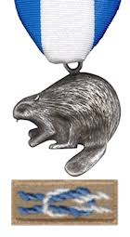

Awards For District and Council Service
District recognition
Scoutmaster of the Year
Troop of the Year
District Award of Merit
  District level service
Silver Beaver
  Council level service
10

Slide 11


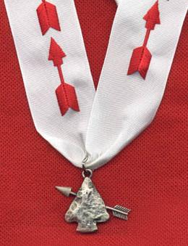
Awards For District and Council Service
Silver Antelope and Buffalo
Area and National level
OA Distinguished Service Award
Service to OA beyond your Lodge
11

Slide 12

Donation Awards
West Fellowship
  Recognizing monetary donations
  Bronze ($1K) through Diamond ($15K) levels
  Cumulative over several years
12

Slide 13
Informal Awards
Unit level, and can be anything you want
  Name a Scout award for a distinguished volunteer
    David Thompson Trail To First Class Award
    Al Bragg Cooking Award
    Tom Garrett Scout Of The Year
  Give out service stars yearly
  Small gift or momento for “retirements”
13

Slide 14
Things To Think About
Timing can be important
  Most should be awarded at a Court of Honor
    Don’t overshadow the Scouts
    Usually a separate segment
  Some are awarded at District meetings
  Some are awarded at Council meetings
14

Slide 15
Takeaways
Most of us know people who have gone above and beyond for our Scouts
Recognition is a concrete way to say THANKS!
Recognition also can motivate other leaders and potential leaders to step up
15

